Slide 1




Design Specifications
IP APB BUS PROTOCOL & SHA-256

Slide 2

Table Content
1
2
3
4
Specifications
High Level Block Design
Low Level Block Design
RTL Verification

Slide 3
1. Specifications

Slide 4
1.1. SHA

Slide 5
1.1. SHA
1.1.1. Overview of the SHA Algoritm
The Secure Hash Algorithm (SHA) is a family of cryptographic hash functions designed to ensure data integrity and security. It is widely used in digital signatures, SSL/TLS certificates, password hashing, and blockchain systems. SHA was developed by the National Security Agency (NSA) and published by the National Institute of Standards and Technology (NIST) as a U.S. Federal Information Processing Standard (FIPS), including:
Version | Output Size | Status
SHA-1 | 160 bits | Deprecated (collision found)
SHA-2 | 224, 256, 384, 512 bits | Secure and widely used
SHA-3 | 224, 256, 384, 512 bits | Newer alternative

Slide 6
1.1. SHA
1.1.1. Overview of the SHA Algorithm
SHA-2 is a family of cryptographic hash functions designed by the National Security Agency (NSA) and standardized by the National Institute of Standards and Technology (NIST) in FIPS 180-2 (2001) and later updated in FIPS 180-4. It was developed as a successor to SHA-1 to provide stronger security against collision and preimage attacks. Today, SHA-2 is the most widely used hash family in cybersecurity applications.
Algorithm | Output Size | Block Size | Word Size | Rounds | Security Level | Typical Use
SHA-224 | 224 bits | 512 bits | 32-bit | 64 | High | Embedded systems
SHA-256 | 256 bits | 512 bits | 32-bit | 64 | Very High | TLS, Blockchain
SHA-384 | 384 bits | 1024 bits | 64-bit | 80 | Very High | High-security applications
SHA-512 | 512 bits | 1024 bits | 64-bit | 80 | Extremely High | Digital signatures
SHA-512/224 | 224 bits | 1024 bits | 64-bit | 80 | High | Constrained systems
SHA-512/256 | 256 bits | 1024 bits | 64-bit | 80 | Very High | Secure alternatives to SHA-256

Slide 7
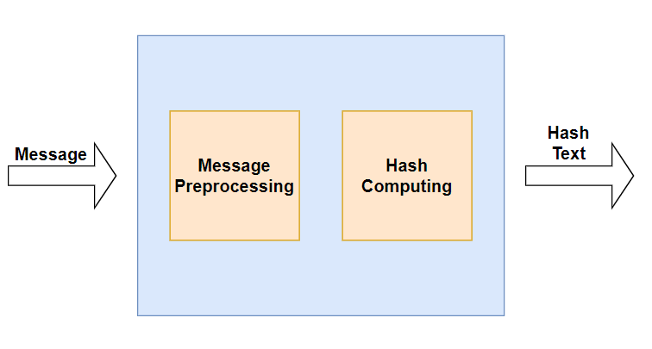
1.1. SHA
1.1.2. Key features of the SHA-256 Algorithm
The SHA-256 algorithm takes an input message of up to 264 bits and produces a fixed-length 256-bit output hash. The algorithm consists of two main stages: message preprocessing and hash computation.
Message: < 2⁶⁴ bit
Hash Text: 256 bit
Step: 80

Slide 8
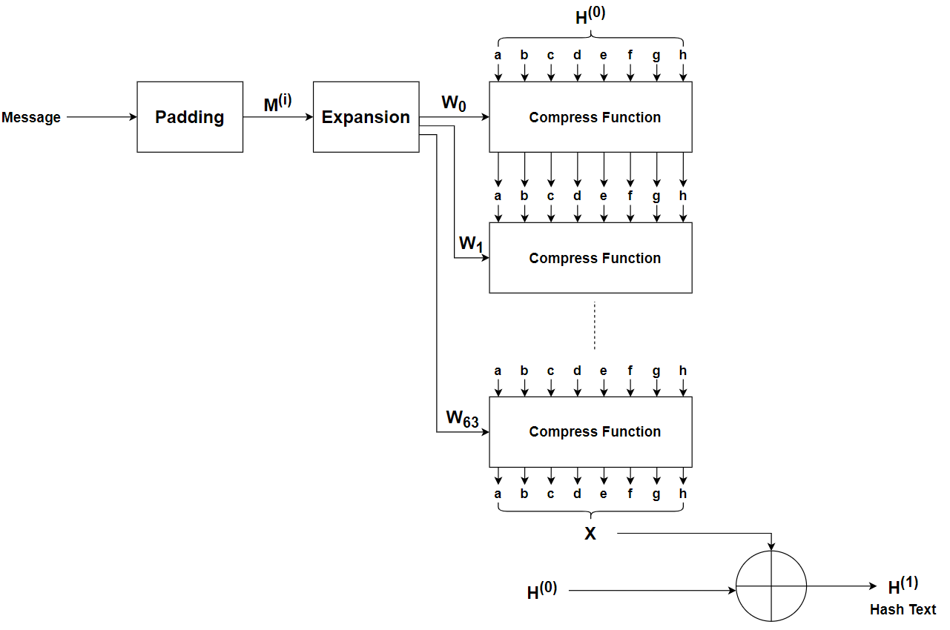
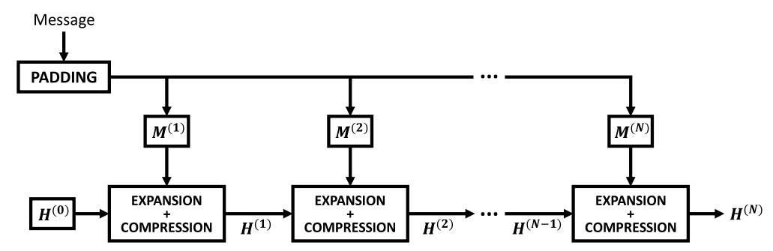
1.1. SHA
1.1.2 Key features of the SHA-256 Algorithm

Slide 9
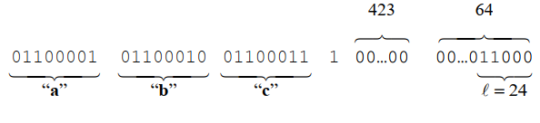
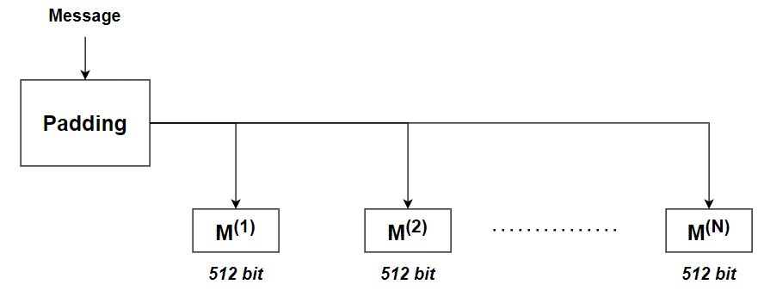
1.1. SHA
1.1.2 Key features of the SHA-256 Algorithm
Message Preprocessing Stage:
In the preprocessing stage, the input message is first encoded in the UTF-8 binary standard. Next, a 1-value bit is added
to the end of the L-length encoded input message as a delimiter, signaling the end of the binary sequence. Afterward, the delimited string is zero-padded to a length of k bits, and the original input message’s length L is appended to the end in a 64-bit big-endian format. The value of k is determined as the smallest non-negative integer that satisfies the equation (L + 1 + k + 64)mod512 ≡ 0, where the notation (A)modB ≡ 0 means that A is an integer multiple of B. Then, the padded message is partitioned into a series of 512-bit blocks, denoted as M^{(i)}, where i ranges from 1 to N. Each of these blocks comprises sixteen 32-bit words, represented as M^{(i)}_{t}, with t ranging from 0 to 15

Slide 10
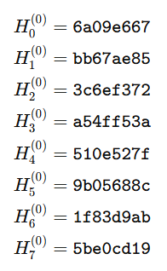
1.1. SHA
1.1.2 Key features of the SHA-256 Algorithm
Message Preprocessing Stage:
Finally, the last step of the preprocessing stage is initializing the working variables.These variables store the hash value and are refreshed each round of the algorithm. The symbols a, b, c, d, e, f , g, and h represent the working variables and are initialized with their respective values: H₀⁽⁰⁾, H₁⁽⁰⁾, . . . , H₇⁽⁰⁾

Slide 11
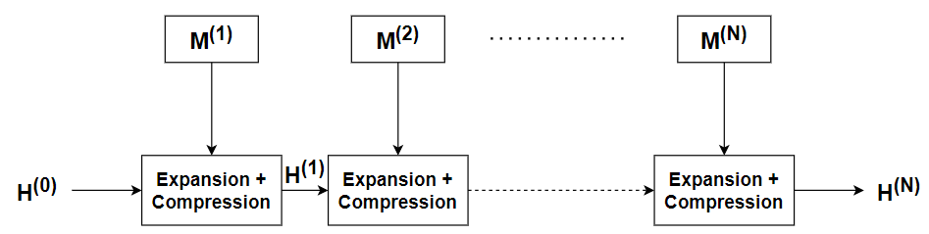
1.1. SHA
1.1.2 Key features of the SHA-256 Algorithm
Hash Computing Stage:

Slide 12
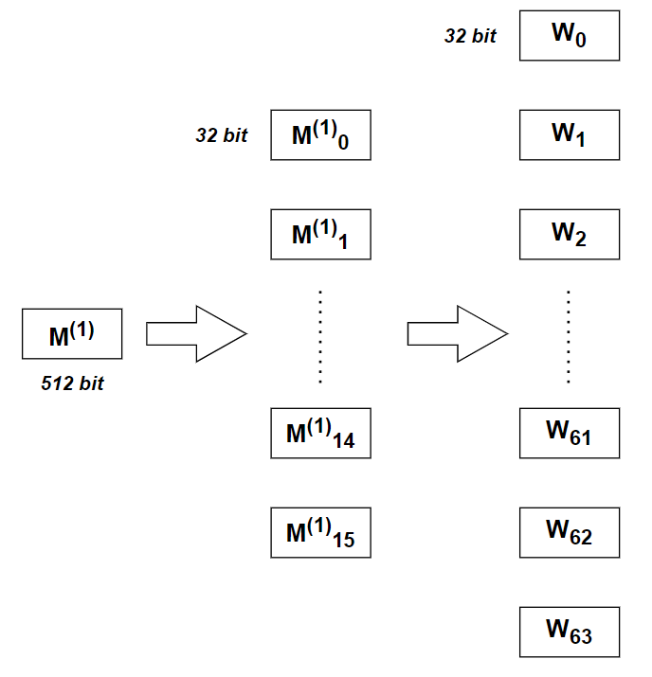
1.1. SHA
1.1.2 Key features of the SHA-256 Algorithm
Hash Computing Stage:
1. Expansion
The hash computation stage starts by taking the 512-bit blocks generated in the preprocessing phase and feeding them into the expander module. This process expands the original sixteen 32-bit words M_{t}^{(i)} into sixty-four 32-bit words denoted by W_{t}.
for t from 0 to 63 do if 0 ≤ t ≤ 15 then W_{t} = M_{t}^{(i)} else W_{t} = s1(W_{t-2}) + W_{t-7} + s0(W_{t-15}) + W_{t-16} return W
With:
s0(x) = ROTR7(x) ⊕ ROTR18(x) ⊕ SHR3(x) s1(x) = ROTR17(x) ⊕ ROTR19(x) ⊕ SHR10(x)

Slide 13
1.1. SHA
1.1.2 Key features of the SHA-256 Algorithm
Hash Computing Stage:
2. Compression
The next stage of the SHA-256 algorithm involves computing the expanded message digest through 64 iterations of the compression function. This stage utilizes the state variables a, b, . . . , h, which were initialized during the preprocessing phase in conjunction with sixty-four 32-bit constants labeled as Kt and defined by FIPS 180-4
for t from 0 to 63 do T1 = h + S1(e) + Ch(e, f , g) + Kt + Wt T2 = S0(a) + Maj(a, b, c) h = g g = f f = e e = d + T1 d = c c = b b = a a = T1 + T2 return X = [a, b, c, d, e, f , g, h]
Ch(x, y, z) = (x & y) ⊕ (~x & z) Maj(x, y, z) = (x & y) ⊕ (x & z) ⊕ (y & z) S0(x) = ROTR2(x) ⊕ ROTR13(x) ⊕ ROTR22(x) S1(x) = ROTR6(x) ⊕ ROTR11(x) ⊕ ROTR25(x)

Slide 14
1.1. SHA
1.1.2 Key features of the SHA-256 Algorithm
Hash Computing Stage:
2. Compression
After 64 iterations, the intermediate hash H^{(i)} for the respective block is computed as the sum of initialization hash H^{(i-1)} with the final value in Compression Function. This operation sequence is repeated for each message block (i = 1, 2, . . . , N), and the final 256-bit message digest is obtained by concatenating the result hashes for i = N.
Initialization()
M = Padding(message)
for i from 1 to N do
W = Expansion(M(i))
X = Compression(W)
for j from 0 to 7 do
H(i)j = Xj + Hj(i−1)
return H(N) = H0(N) || H1(N) || H2(N) || H3(N) || H4(N) || H5(N) || H6(N) || H7(N)

Slide 15
1.2. APB BUS PROTOCOL

Slide 16
1.2. APB BUS PROTOCOL
1.2.1 Overview of the AMBA specification
AMBA (Advanced Microcontroller Bus Architecture)
Developed by: ARM
Purpose: Standard on-chip interconnect for SoC (System-on-Chip) designs
Goal: Enable efficient communication between processors, memory, and peripherals
Four distinct buses are defined within the AMBA specification:
The Advanced High-performance Bus (AHB)
The Advanced System Bus (ASB)
The Advanced Peripheral Bus (APB).
The Advanced eXtensible Interface (AXI)
Main Advantages
High bandwidth & low latency
Scalable and modular architecture
Widely adopted industry standard
Supports low-power and high-performance design

Slide 17
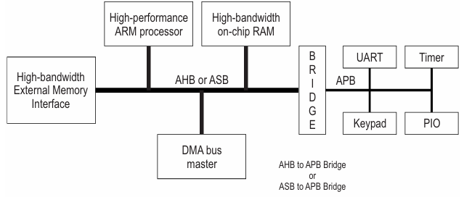
1.2. APB BUS PROTOCOL
1.2.1 Overview of the AMBA specification
AMBA AXI | AMBA AHB | AMBA ASB | AMBA APB
Very high performance | High performance | High performance | Low power
Fully pipelined | Pipelined operation | Pipelined operation | Latched address and control
Multiple masters | Multiple bus masters | Multiple bus masters | Single master
Separate read/write channels | Burst transfers | Burst transfers | No burst support
Out-of-order transactions | Split transactions | Central arbitration | Simple interface
High bandwidth, low latency | Shared bus architecture | Synchronous bus | Suitable for many peripherals

Slide 18
1.2. APB BUS PROTOCOL
1.2.2 Key features of the AMBA Advanced Peripheral Bus (APB)
Low-cost interface: APB is designed with a simple architecture that minimizes hardware resources and implementation cost.
Low power consumption: The non-pipelined and simple transfer mechanism helps reduce power usage, making APB suitable for peripheral devices.
Synchronous protocol: All APB transactions are synchronized to the system clock.
Non-pipelined operation: Transfers are performed sequentially without overlapping phases.
Low bandwidth, optimized for control register access APB is intended for accessing programmable control registers rather than high-throughput data transfers.

Slide 19
1.2. APB BUS PROTOCOL
1.2.2 Key features of the AMBA Advanced Peripheral Bus (APB)
Designed for simple peripheral devices: Commonly used for peripherals such as GPIO, Timers, UART, SPI, and I2C.
Accessed through an APB bridge: APB peripherals are typically connected to the main system bus through a bridge (e.g., AXI-to-APB bridge).
Clear Requester–Completer model:
The APB bridge acts as the Requester, initiating transactions.
The peripheral device acts as the Completer, responding to requests.
Well-suited for AMBA-based multi-bus systems: APB integrates seamlessly with other AMBA buses such as AXI and AHB via bridges.

Slide 20
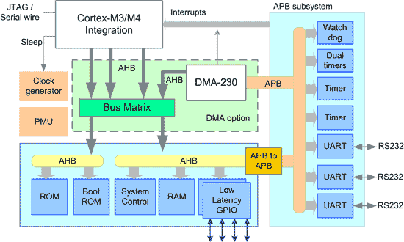
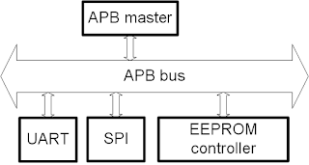
1.2. APB BUS PROTOCOL
1.2.2 Key features of the AMBA Advanced Peripheral Bus (APB)

Slide 21
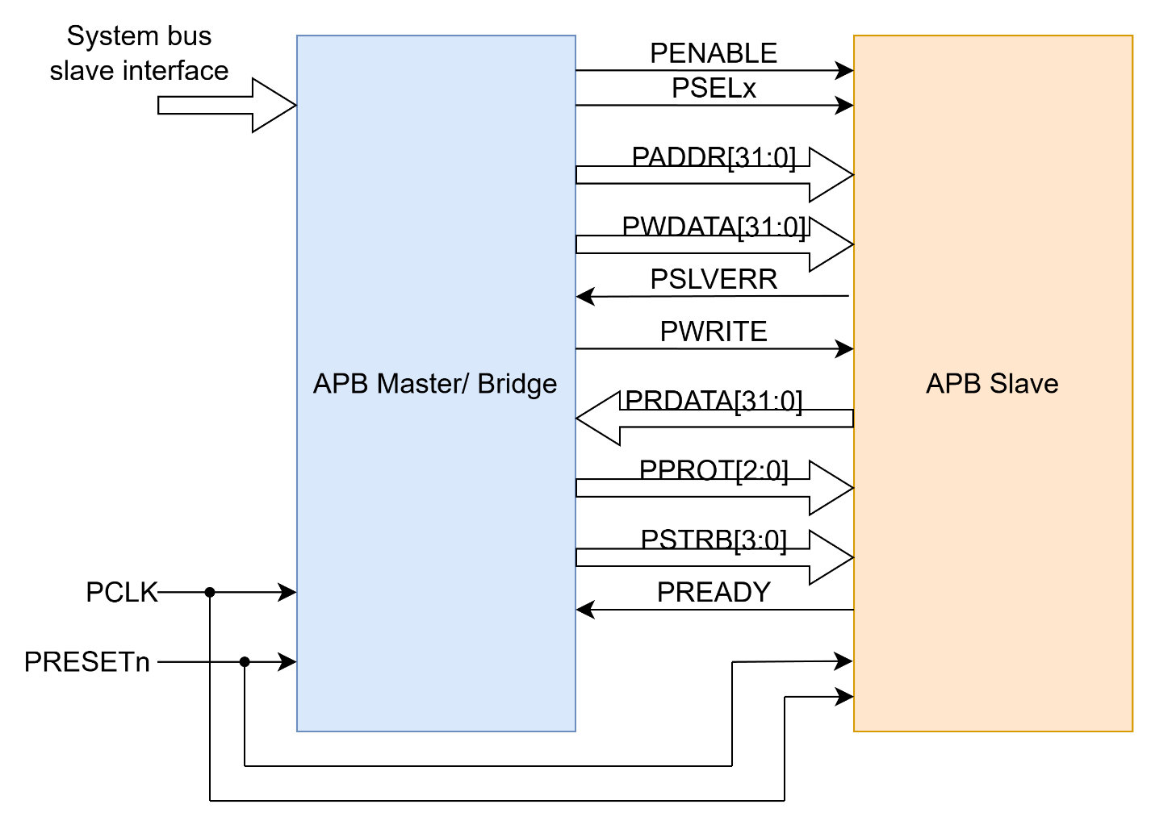
1.2. APB BUS PROTOCOL
1.2.3 AMBA ABP signals
Block Diagram & Signal Description of APB

Slide 22
1.2. APB BUS PROTOCOL
1.2.3 AMBA ABP signals
Signal | Source | Width | Description
PCLK | Clock Source | 1 | Clock. The rising edge of PCLK times all transfer on the APB
PRESETn | System Bus | 1 | Reset. The APB reset signal is active LOW. This signal is normally connected directly to the system bus reset signal.
PADDR | APB bridge | ADDR_WIDTH | Address. This is APB address bus. It can be up to 32 bits wide and is driven by the peripheral bus bridge unit.
PPROT | APB bridge | 3 | Protection type. This signal indicates the normal, privileged, or secure protection level of the transaction and whether the transaction is a data access or an instruction access.
PSELx | APB bridge | 1 | Slave select signal, there will be one PSEL signal for each slave connected to master.. It’s an active high signal.
PENABLE | APB bridge | 1 | Enable. It indicates the 2nd cycle of a data transfer. It’s an active high signal.

Slide 23
1.2. APB BUS PROTOCOL
1.2.3 AMBA ABP signals
Signal | Source | Width | Description
PWRITE | APB bridge | 1 | Direction. PWRITE indicates an APB write access when HIGH and an APB read access when LOW.
PWDATA | APB bridge | DATA_WIDTH | Write data. Write data bus from Master to Slave, can be up to 32 bit wide
PSTRB | APB bridge | DATA_WIDTH/8 | Write strobe. PSTRB indicates which byte lanes to update during a write transfer. There is one write strobe for each 8 bits of the write data bus. PSTRB[n] corresponds to PWDATA[(8n + 7):(8n)]. PSTRB must not be active during a read transfer.
PREADY | Slave Interface | 1 | It is used by the slave to include wait states in the transfer. i.e. whenever slave is not ready to complete the transaction, it will request the master for some time by de-asserting the PREADY.
PSLVERR | Slave Interface | 1 | Indicates the Success or failure of the transfer. HIGH indicates failure and LOW indicates Success
PRDATA | Slave Interface | DATA_WIDTH | Read data us from Slave to Master, can be up to 32 bit wide

Slide 24
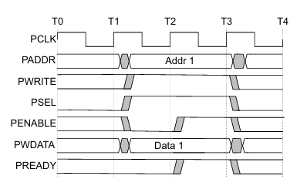
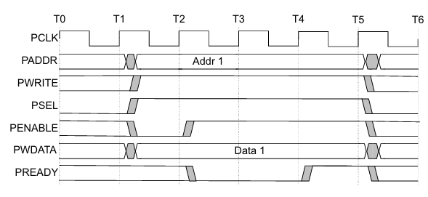
1.2. APB BUS PROTOCOL
1.2.4 APB Transfers – Write transfers
WRITE Transfer – Without Wait States
WRITE Transfer – With Wait States

Slide 25
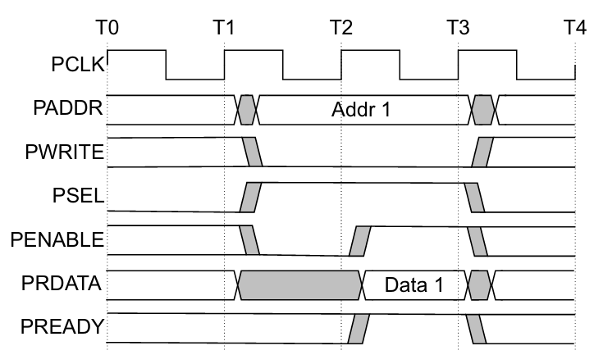
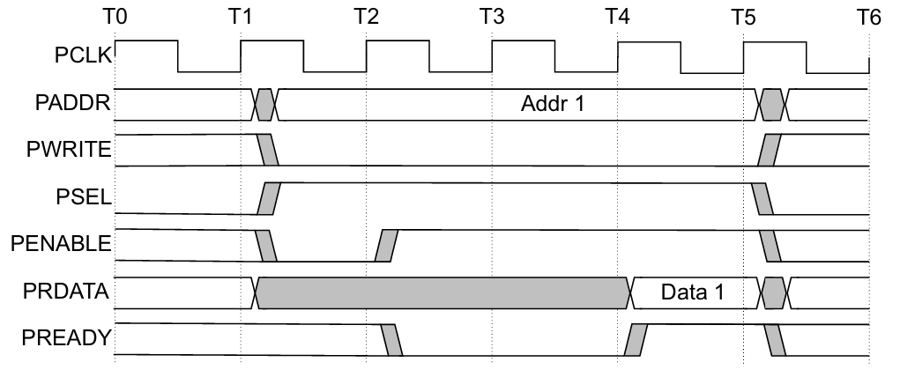
1.2. APB BUS PROTOCOL
1.2.5 APB Transfers – Read transfers
Read Transfer – Without Wait States
Read Transfer – With Wait States

Slide 26
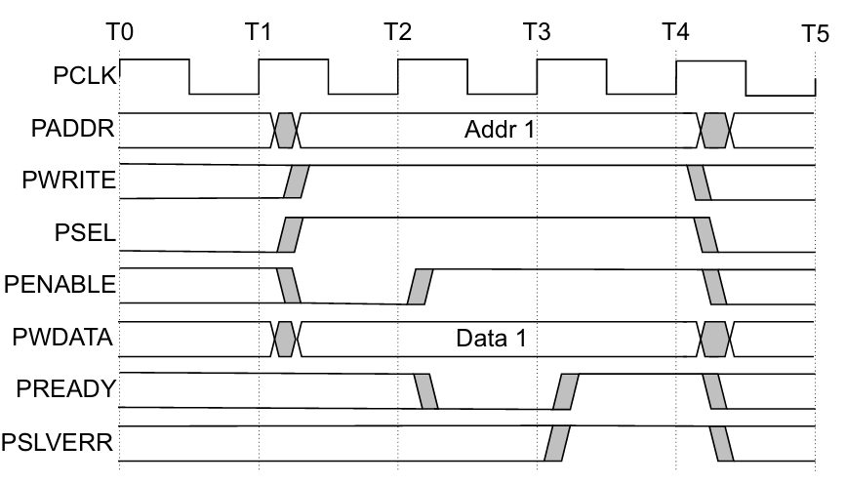
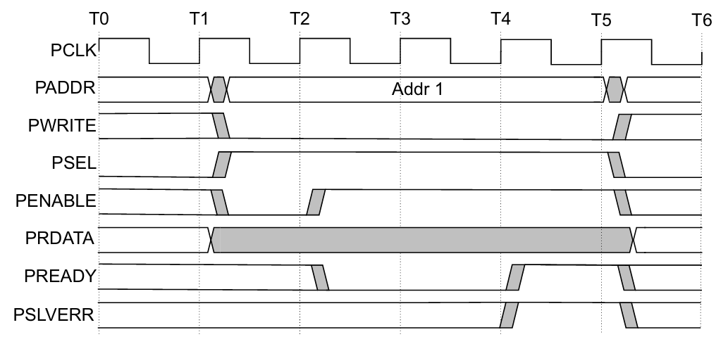
1.2. APB BUS PROTOCOL
1.2.6 APB Transfers – Error response
Write transfers
Read transfers

Slide 27
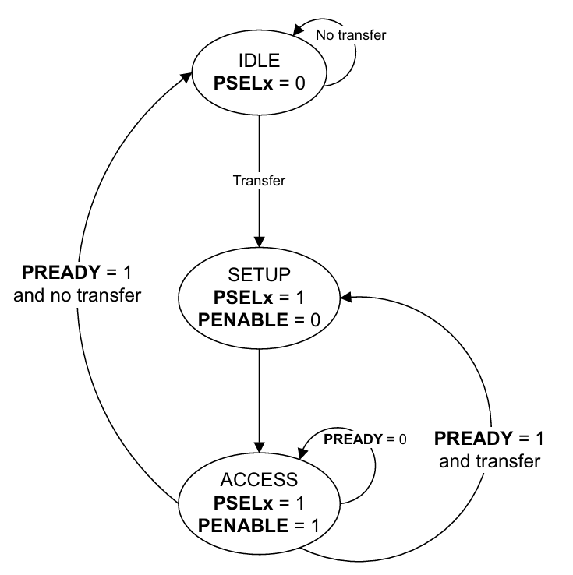
1.2. APB BUS PROTOCOL
1.2.7 Operation States
IDLE | This is the default state of the APB interface.
SETUP | When a transfer is required, the interface moves into the SETUP state, where the appropriate select signal, PSELx, is asserted. The interface only remains in the SETUP state for one clock cycle and always moves to the ACCESS state on the next rising edge of the clock.

Slide 28
1.2. APB BUS PROTOCOL
1.2.7 Operation States
ACCESS | PENABLE is asserted in the ACCESS state. During the transition from SETUP to ACCESS and throughout the ACCESS state, the following signals must remain stable: PADDR, PPROT, PWRITE, PSTRB, PAUSER, PWUSER, and PWDATA (for write transfers only). The exit from the ACCESS state depends on PREADY from the Completer: if PREADY is LOW, the bus stays in ACCESS; if PREADY is HIGH, the bus leaves ACCESS and returns to IDLE or moves directly to SETUP for the next transfer.

Slide 29
2. High Level Block Design

Slide 30
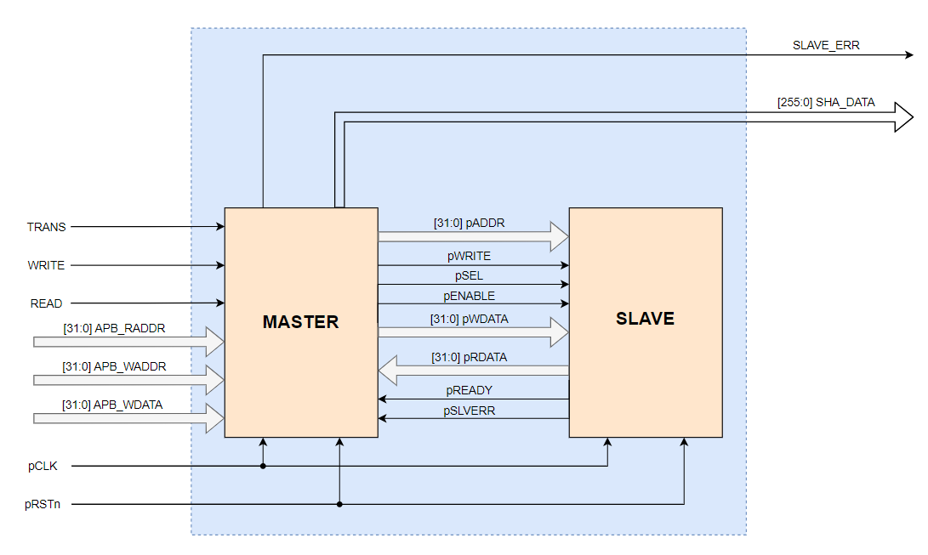
2. High Level Block 2.1. Interface

Slide 31
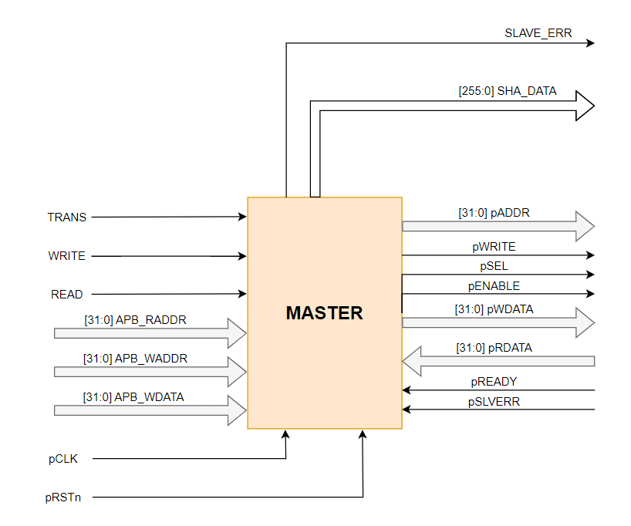
2. High Level Block 2.1. Interface APB_Master:

Slide 32
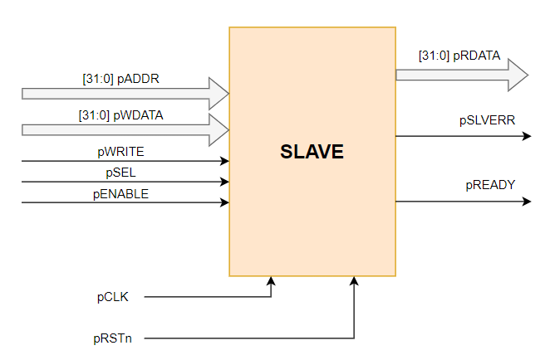
2. High Level Block 2.1. Interface APB_Slave:

Slide 33
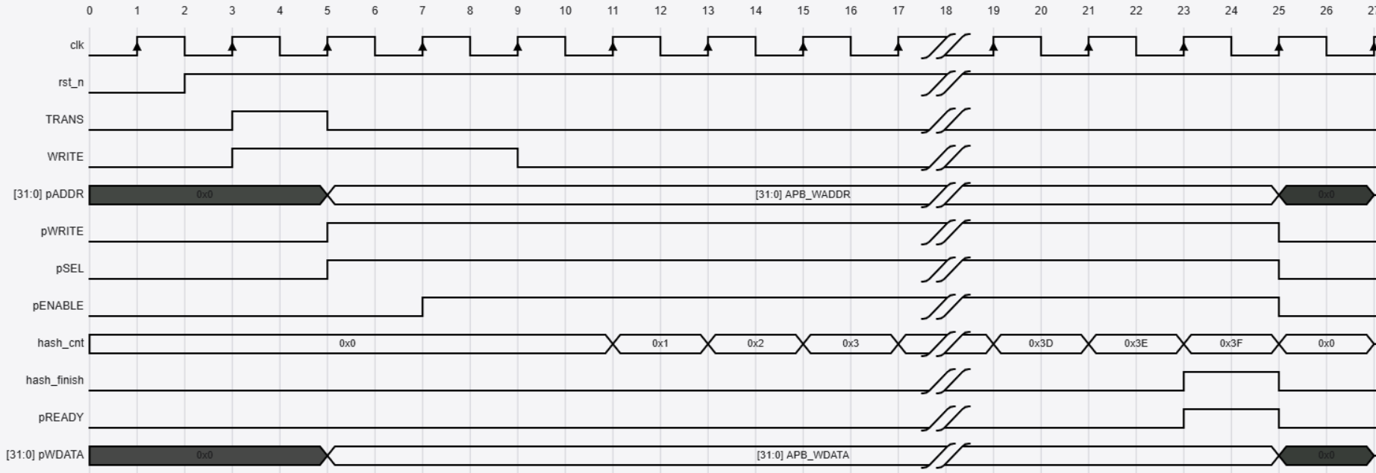
2. High Level Block 2.2. Waveform – Write Transfer

Slide 34
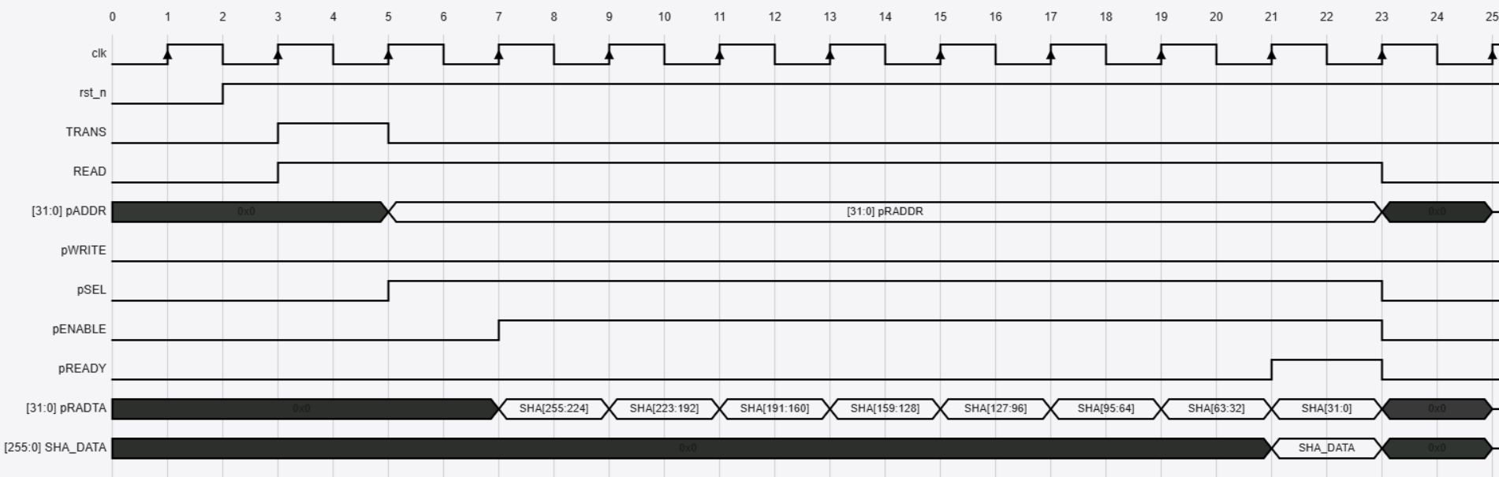
2. High Level Block 2.2. Waveform – Read Transfer

Slide 35
2. High Level Block Design
2.3 AMBA ABP Interface signals
Signal | Source | Width | Description
TRANS | System BUS | 1 | Start signal. When the TRANS signal is set to HIGH, the system will begin operation. This signal may remain active for one clock cycle or multiple cycles.
READ | System BUS | 1 | Read signal.
WRITE | System BUS | 1 | Write signal.
APB_WADDR | System BUS | 32 | Address. This is the APB write address used by the APB master to write data to the slave. The address can be up to 32 bits wide.
APB_WDATA | System BUS | 32 | Data Write. This is the data sent from the APB master to the APB slave during a write operation. The data width can be up to 32 bits.
APB_RADDR | System BUS | 32 | Address. This is the APB read address used by the APB master to read data from the slave. The address can be up to 32 bits wide.
SHA_DATA | System BUS | 256 | Data has been encryption by SHA-256. This is the data which is read from slave. The data width can be up to 256 bits.

Slide 36
2. High Level Block Design
2.3 AMBA ABP Interface signals
Signal | Source | Width | Description
pCLK | Clock Source | 1 | Clock. The rising edge of PCLK times all transfer on the APB
pRESETn | System Bus | 1 | Reset. The APB reset signal is active LOW. This signal is normally connected directly to the system bus reset signal.
pADDR | APB bridge | 32 | Address. This is APB address bus. It can be up to 32 bits wide and is driven by the peripheral bus bridge unit.
pSEL | APB bridge | 1 | Slave select signal, there will be one PSEL signal for each slave connected to master.. It’s an active high signal.
pENABLE | APB bridge | 1 | Enable. It indicates the 2nd cycle of a data transfer. It’s an active high signal.

Slide 37
2. High Level Block Design
2.3 AMBA ABP Interface signals
Signal | Source | Width | Description
pWRITE | APB bridge | 1 | Direction. PWRITE indicates an APB write access when HIGH and an APB read access when LOW.
pWDATA | APB bridge | 32 | Write data. Write data bus from Master to Slave, can be up to 32 bit wide
pREADY | Slave Interface | 1 | It is used by the slave to include wait states in the transfer. i.e. whenever slave is not ready to complete the transaction, it will request the master for some time by de-asserting the PREADY.
pSLVERR | Slave Interface | 1 | Indicates the Success or failure of the transfer. HIGH indicates failure and LOW indicates Success
pRDATA | Slave Interface | 32 | Read data us from Slave to Master, can be up to 32 bit wide
SLAVE_ERR | APB bridge | 1 | Assign to pSLVERR

Slide 38
3. Low Level Block Design

Slide 39
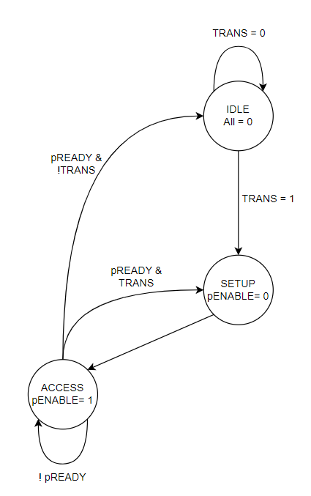
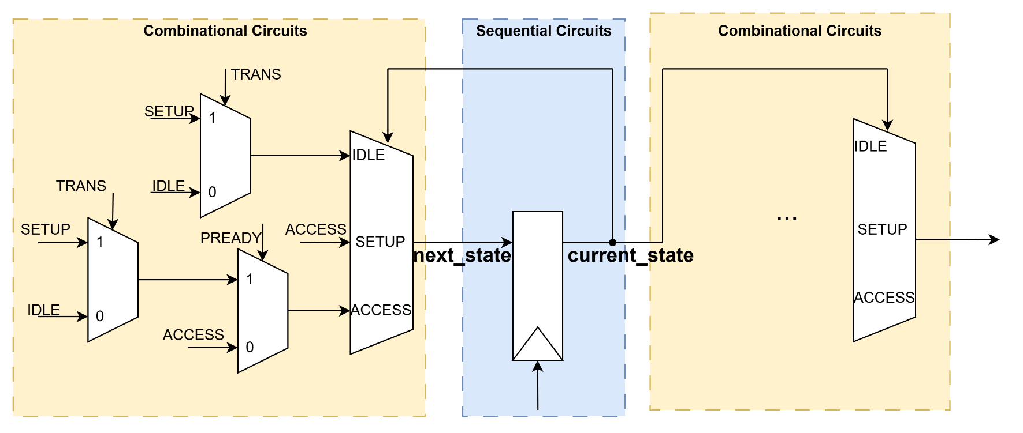
3. Low Level Block 3.1. APB_Master

Slide 40
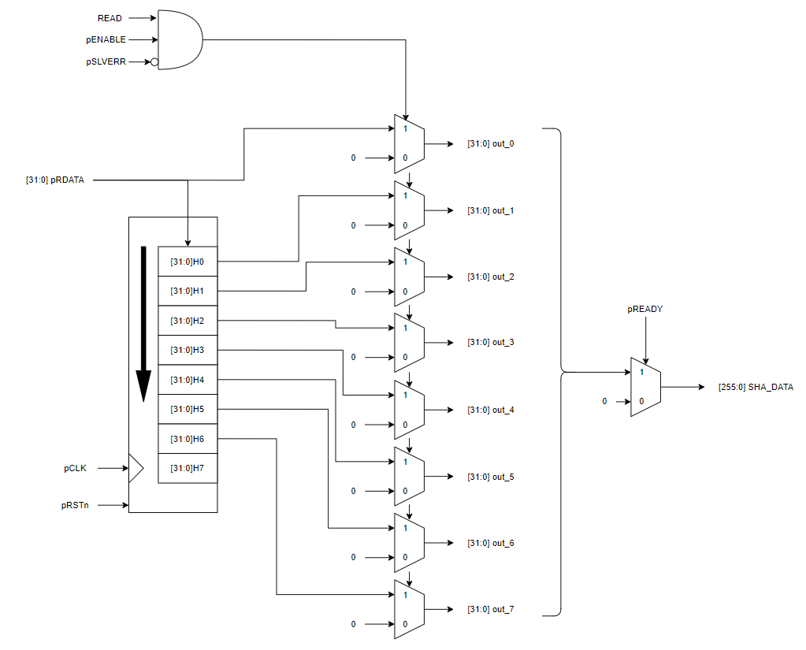
3. Low Level Block 3.1. APB_Master

Slide 41
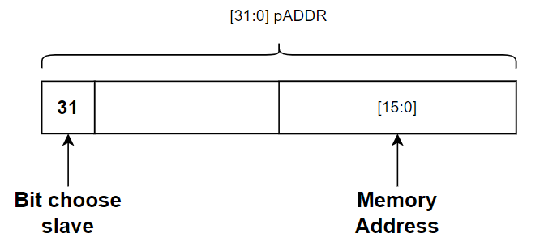
3. Low Level Block 3.1. APB_Slave
BUS Signals | Name | Descriptions
PADDR[31] | Slave Select Bit | Used to select the target slave. 0 selects Slave 0; 1 selects Slave 1.
PADDR[15:0] | Memory Address | These bits represent the internal memory index (Word-aligned). They are used to access specific data entries within the slave's memory array.

Slide 42
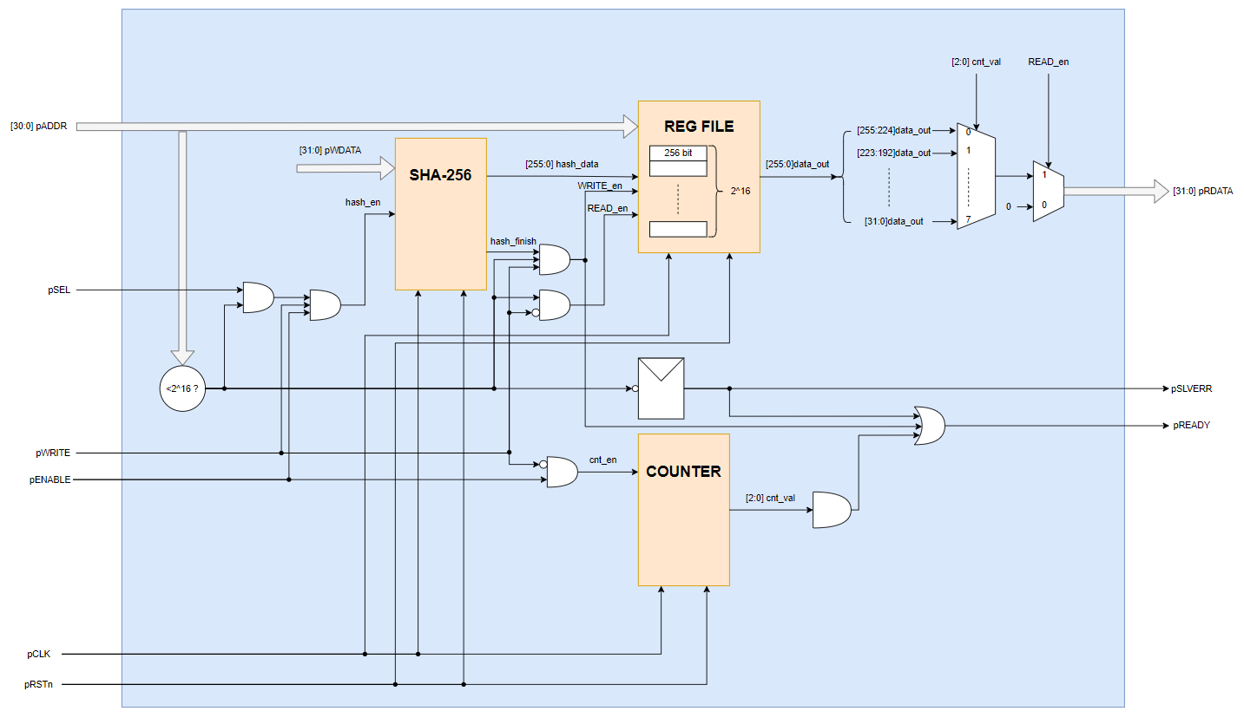
3. Low Level Block 3.1. APB_Slave

Slide 43
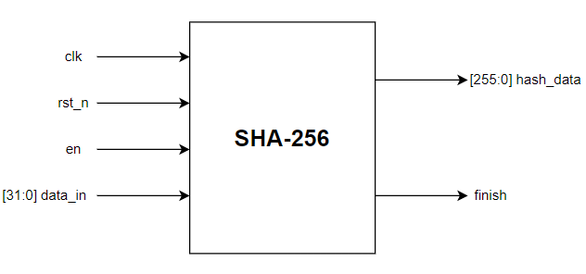
3. Low Level Block 3.2.1 SHA Block:
Port | Size | Direction | Description
clk | 1 | Input | Clock
rst_n | 1 | Input | Asynchronous reset, active LOW
en | 1 | Input | Start signal, active for 1 cycle clock
data_in | 32 | Input | Data in
hash_data | 256 | Output | Hash data
finish | 1 | Output | Signal indicating that the hashing process has been finish

Slide 44
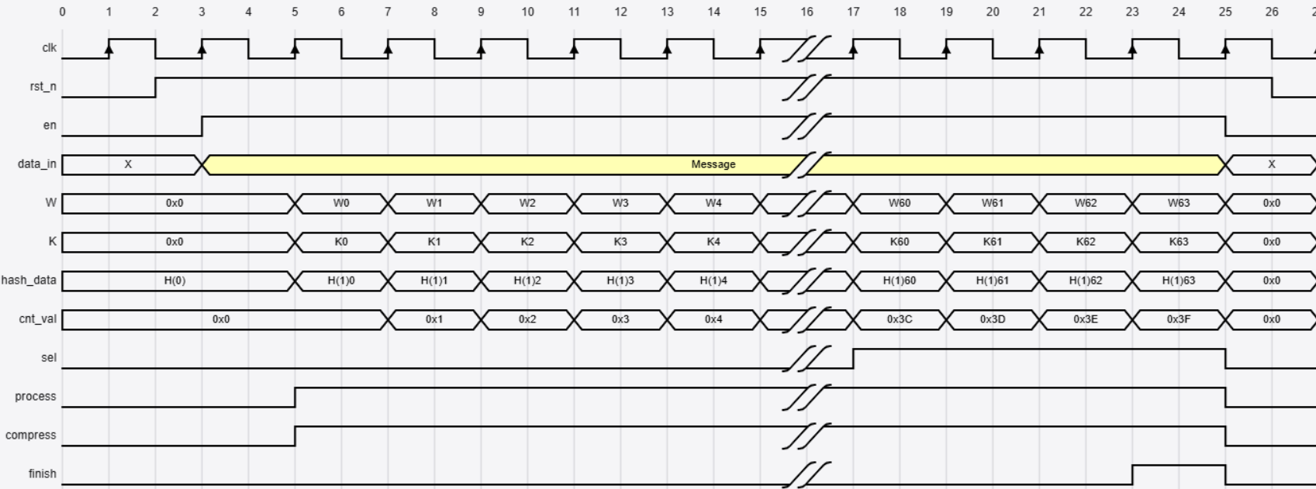
3. Low Level Block 3.2.2 SHA Waveform:

Slide 45
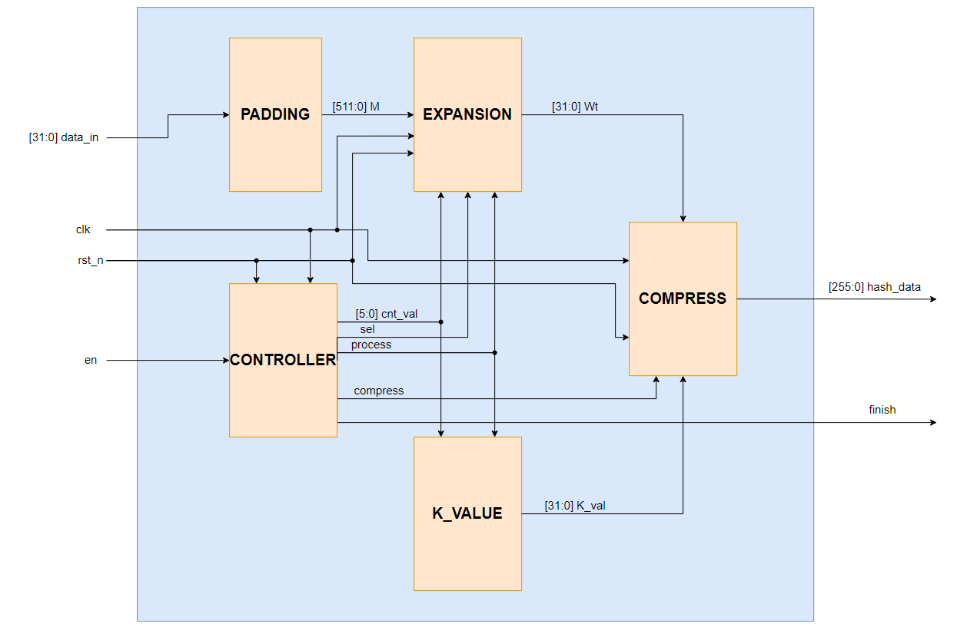
3. Low Level Block 3.2.3 SHA Top:

Slide 46
4. RTL Verification

Slide 47
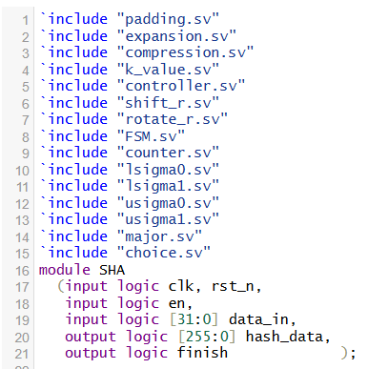
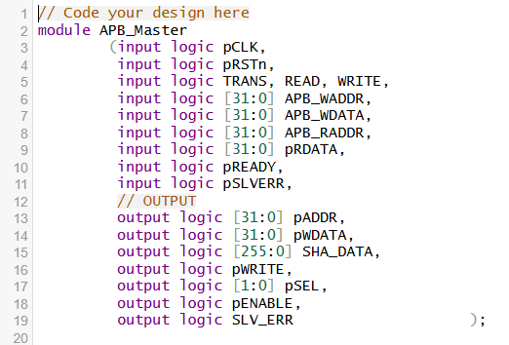
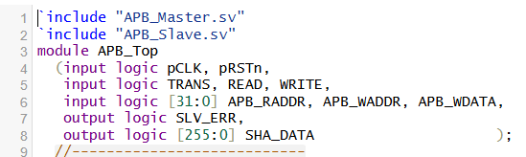
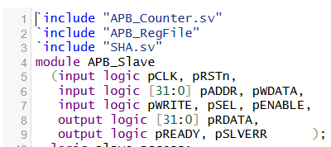
4. RTL Verification
4.1 RTL Design

Slide 48
4. RTL Verification
4.2 Verification Plans
Test case | Descriptions | Expected results
Write/Read Slave 0 | Perform a write of 0x24681357 to address 0x8 (Slave 0) of Slave 0, followed by a read from the same address. | PSELx[0] must be asserted (logic 1).
 |  | SHA_DATA must match the hash value of 0x24681357 (0xce379e80b65d6cfc26f88a27906599a3c24f47a1faffa8a37bc66b091206b5a4).
 |  | PSLVERR must be 0.
Write/Read Slave 1 | Perform a write of 0x1234abcd to address 0x4 (Slave 1) of Slave 1, followed by a read from the same address. | PSELx[1] must be asserted (logic 1).
 |  | SHA_DATA must match the hash value of 0x1234abcd (0x9b11457aa29d65e4940b67b7da16bd370d29bf6a3247a28066f93ac407b8b811).
 |  | PSLVERR must be 0.
Address Range Error | Access (Read/Write) address 0x00010000, which exceeds the memory size (pADDR[15:0]) of the Slave. | Slave must still respond with PREADY = 1.
 |  | PSLVERR signal must be asserted (logic 1) during both Write and Read cycles.
 |  | SHA_DATA should return 0.

Slide 49
4. RTL Verification
4.2 Verification Plans
Test case | Descriptions | Expected results
Empty Address | READ empty address 0x1 | Slave must still respond with PREADY = 1.
 |  | PSLVERR signal must be 0
 |  | SHA_DATA should return 0.

Slide 50
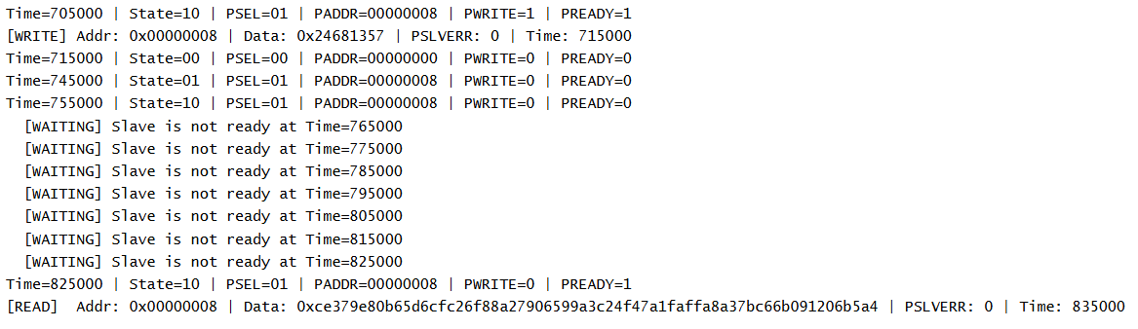
4. RTL Verification
4.3 Results
Write and Read Slave 0
Write Data: 0x24681357
SHA_DATA: 0xce379e80b65d6cfc26f88a27906599a3c24f47a1faffa8a37bc66b091206b5a4
ADDR: 0x08

Slide 51
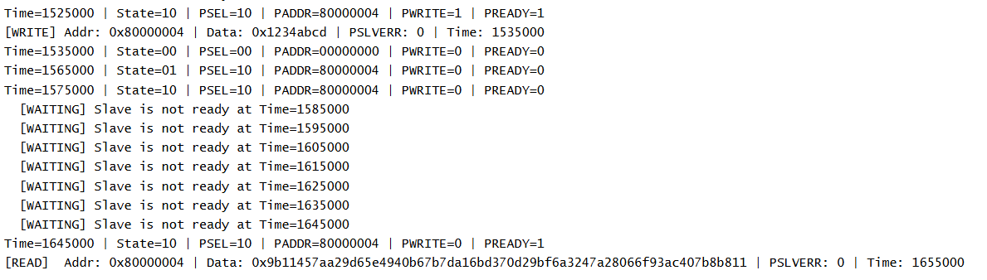
4. RTL Verification
4.3 Results
Write and Read Slave 1
Write Data: 0x1234abcd
SHA_DATA: 0x9b11457aa29d65e4940b67b7da16bd370d29bf6a3247a28066f93ac407b8b811
ADDR: 0x80000004

Slide 52
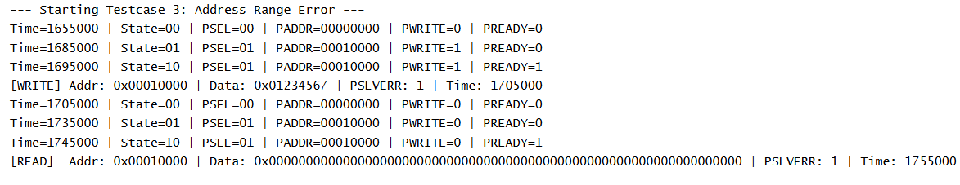
4. RTL Verification
4.3 Results
Write and Read Range Error Address
Write Data: 0x01234567
SHA_DATA: 0
ADDR: 0x00010000
pSLVERR: 1

Slide 53
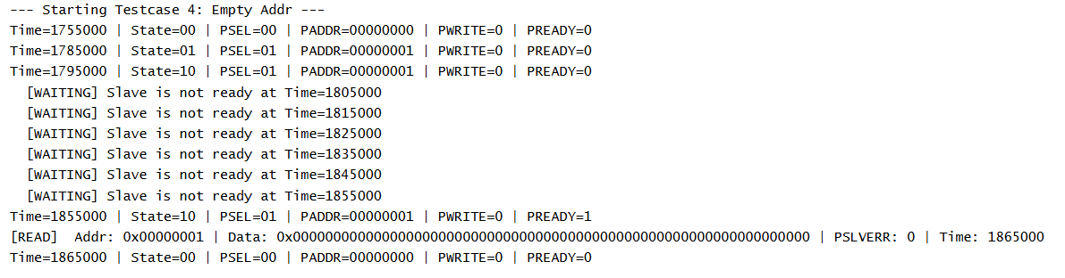
4. RTL Verification
4.3 Results
Read Empty Address
SHA_DATA: 0
ADDR: 0x1
pSLVERR: 0

Slide 54
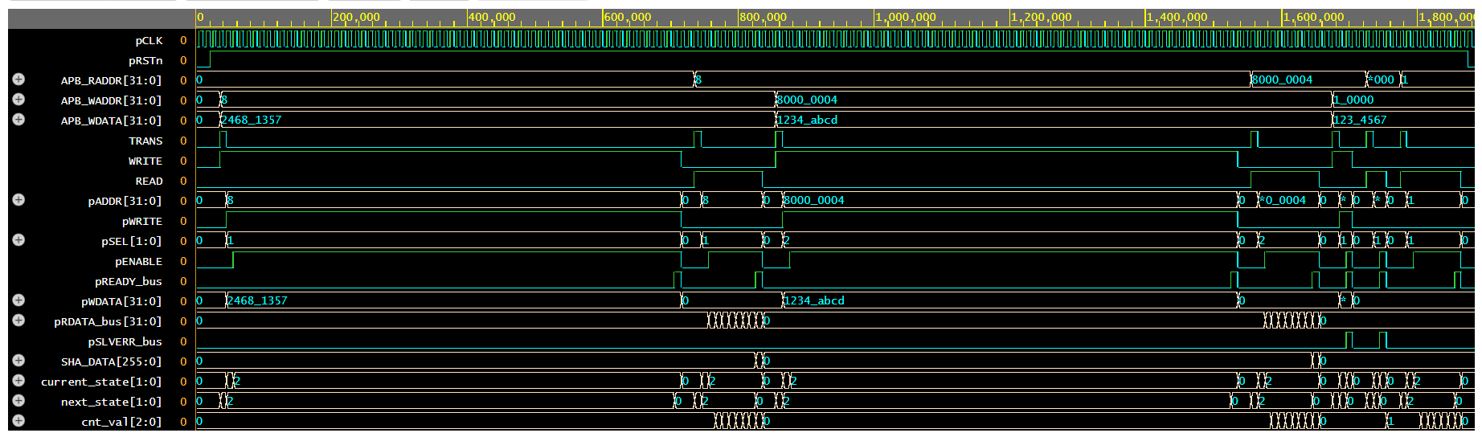
4. RTL Verification
4.3 Results

Slide 55




Thanks for watching

